Slide 1
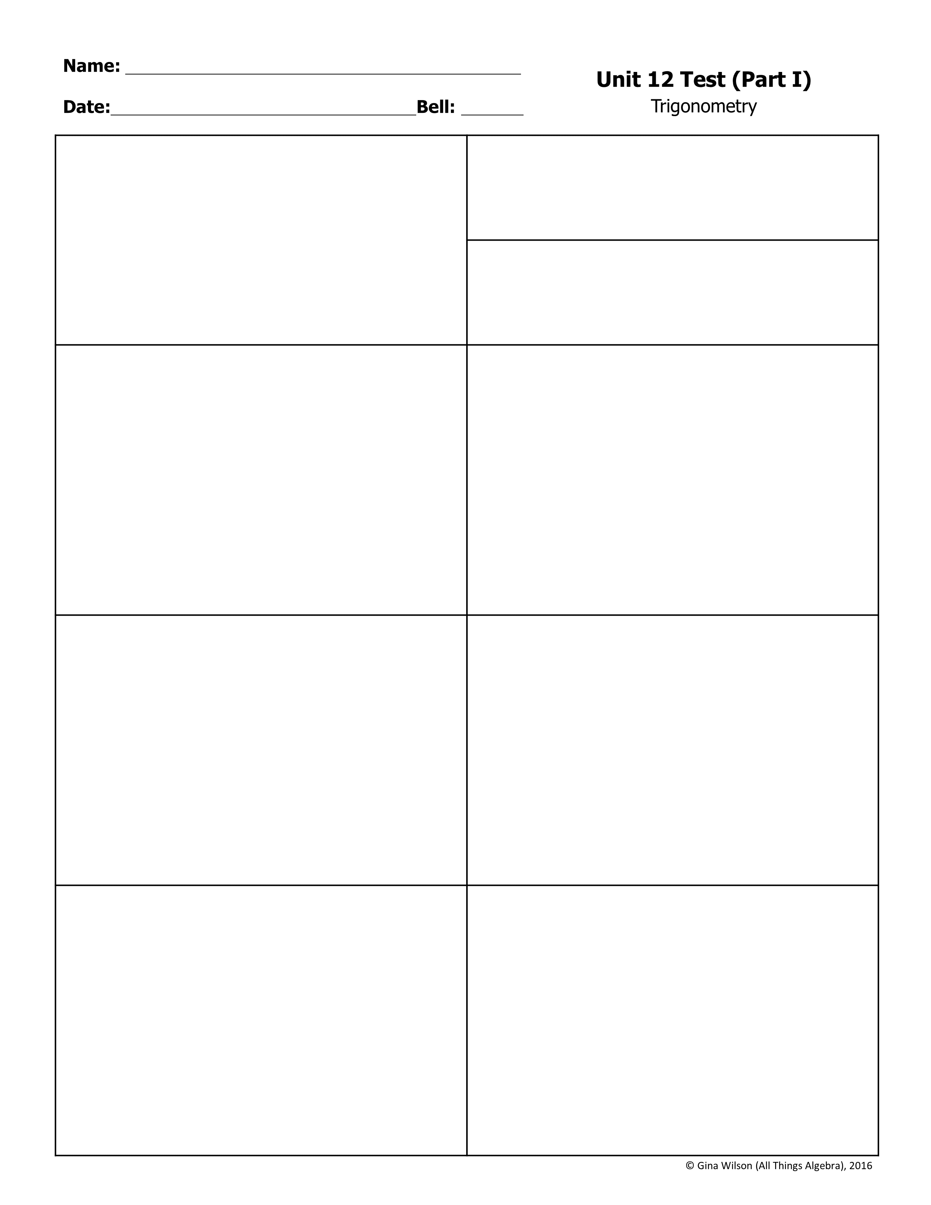
For questions 1-2, use the diagram below to give the exact trigonometric ratios.
1.
A. B. C. D.
7
2.
A. B. C. D.
24
3. If , find .
4. If , find .
A. C. B. D.
A. C. B. D.
5. Find x to the nearest tenth.
6. Find x to the nearest tenth.
x
33°
16
76°
x
21
x =
x =
7. Find the measure of θ to the nearest tenth.
8. Find the measure of θ to the nearest tenth.
32
θ
26
11
11.8
θ =
θ =

Slide 2
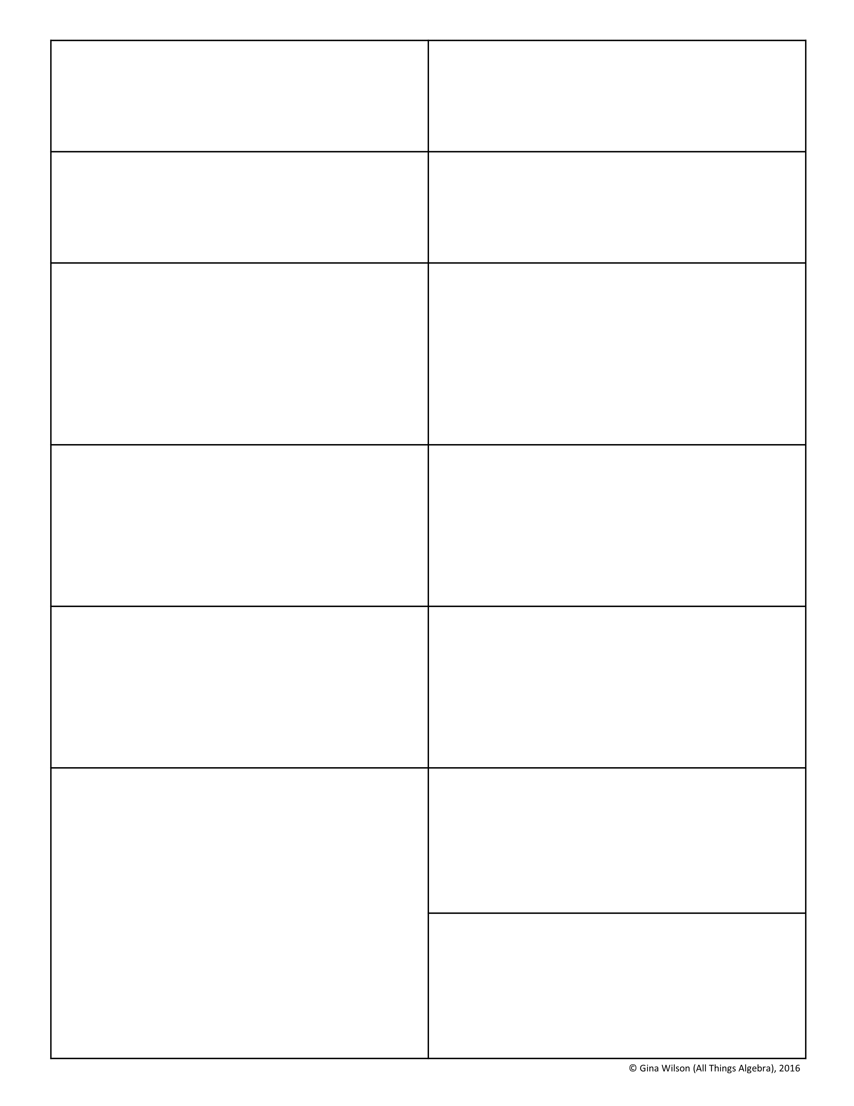
9. Convert 63° to radians.
10. Convert -280° to radians.
11. Convert to degrees.
12. Convert to degrees.
13. The terminal side of an angle measuring radians lies in which quadrant?
14. The terminal side of an angle measuring radians lies in which quadrant?
A. I B. II C. III D. IV
A. I B. II C. III D. IV
15. Which angle is coterminal to 128°?
16. Which angle is coterminal to ?
A. -52° B. 308° C. 232° D. 488°
A. C. B. D.
17. Name the reference angle to 205°.
18. Name the reference angle to .
A. 15° B. 25° C. 65° D. 75°
A. C. B. D.
Use for questions 19-20:
19.
The terminal side of θ in standard position contains the point (-4, -2). Find the exact value for each trigonometric function.
A. B. C. D.
20.
A. B. C. D.

Slide 3
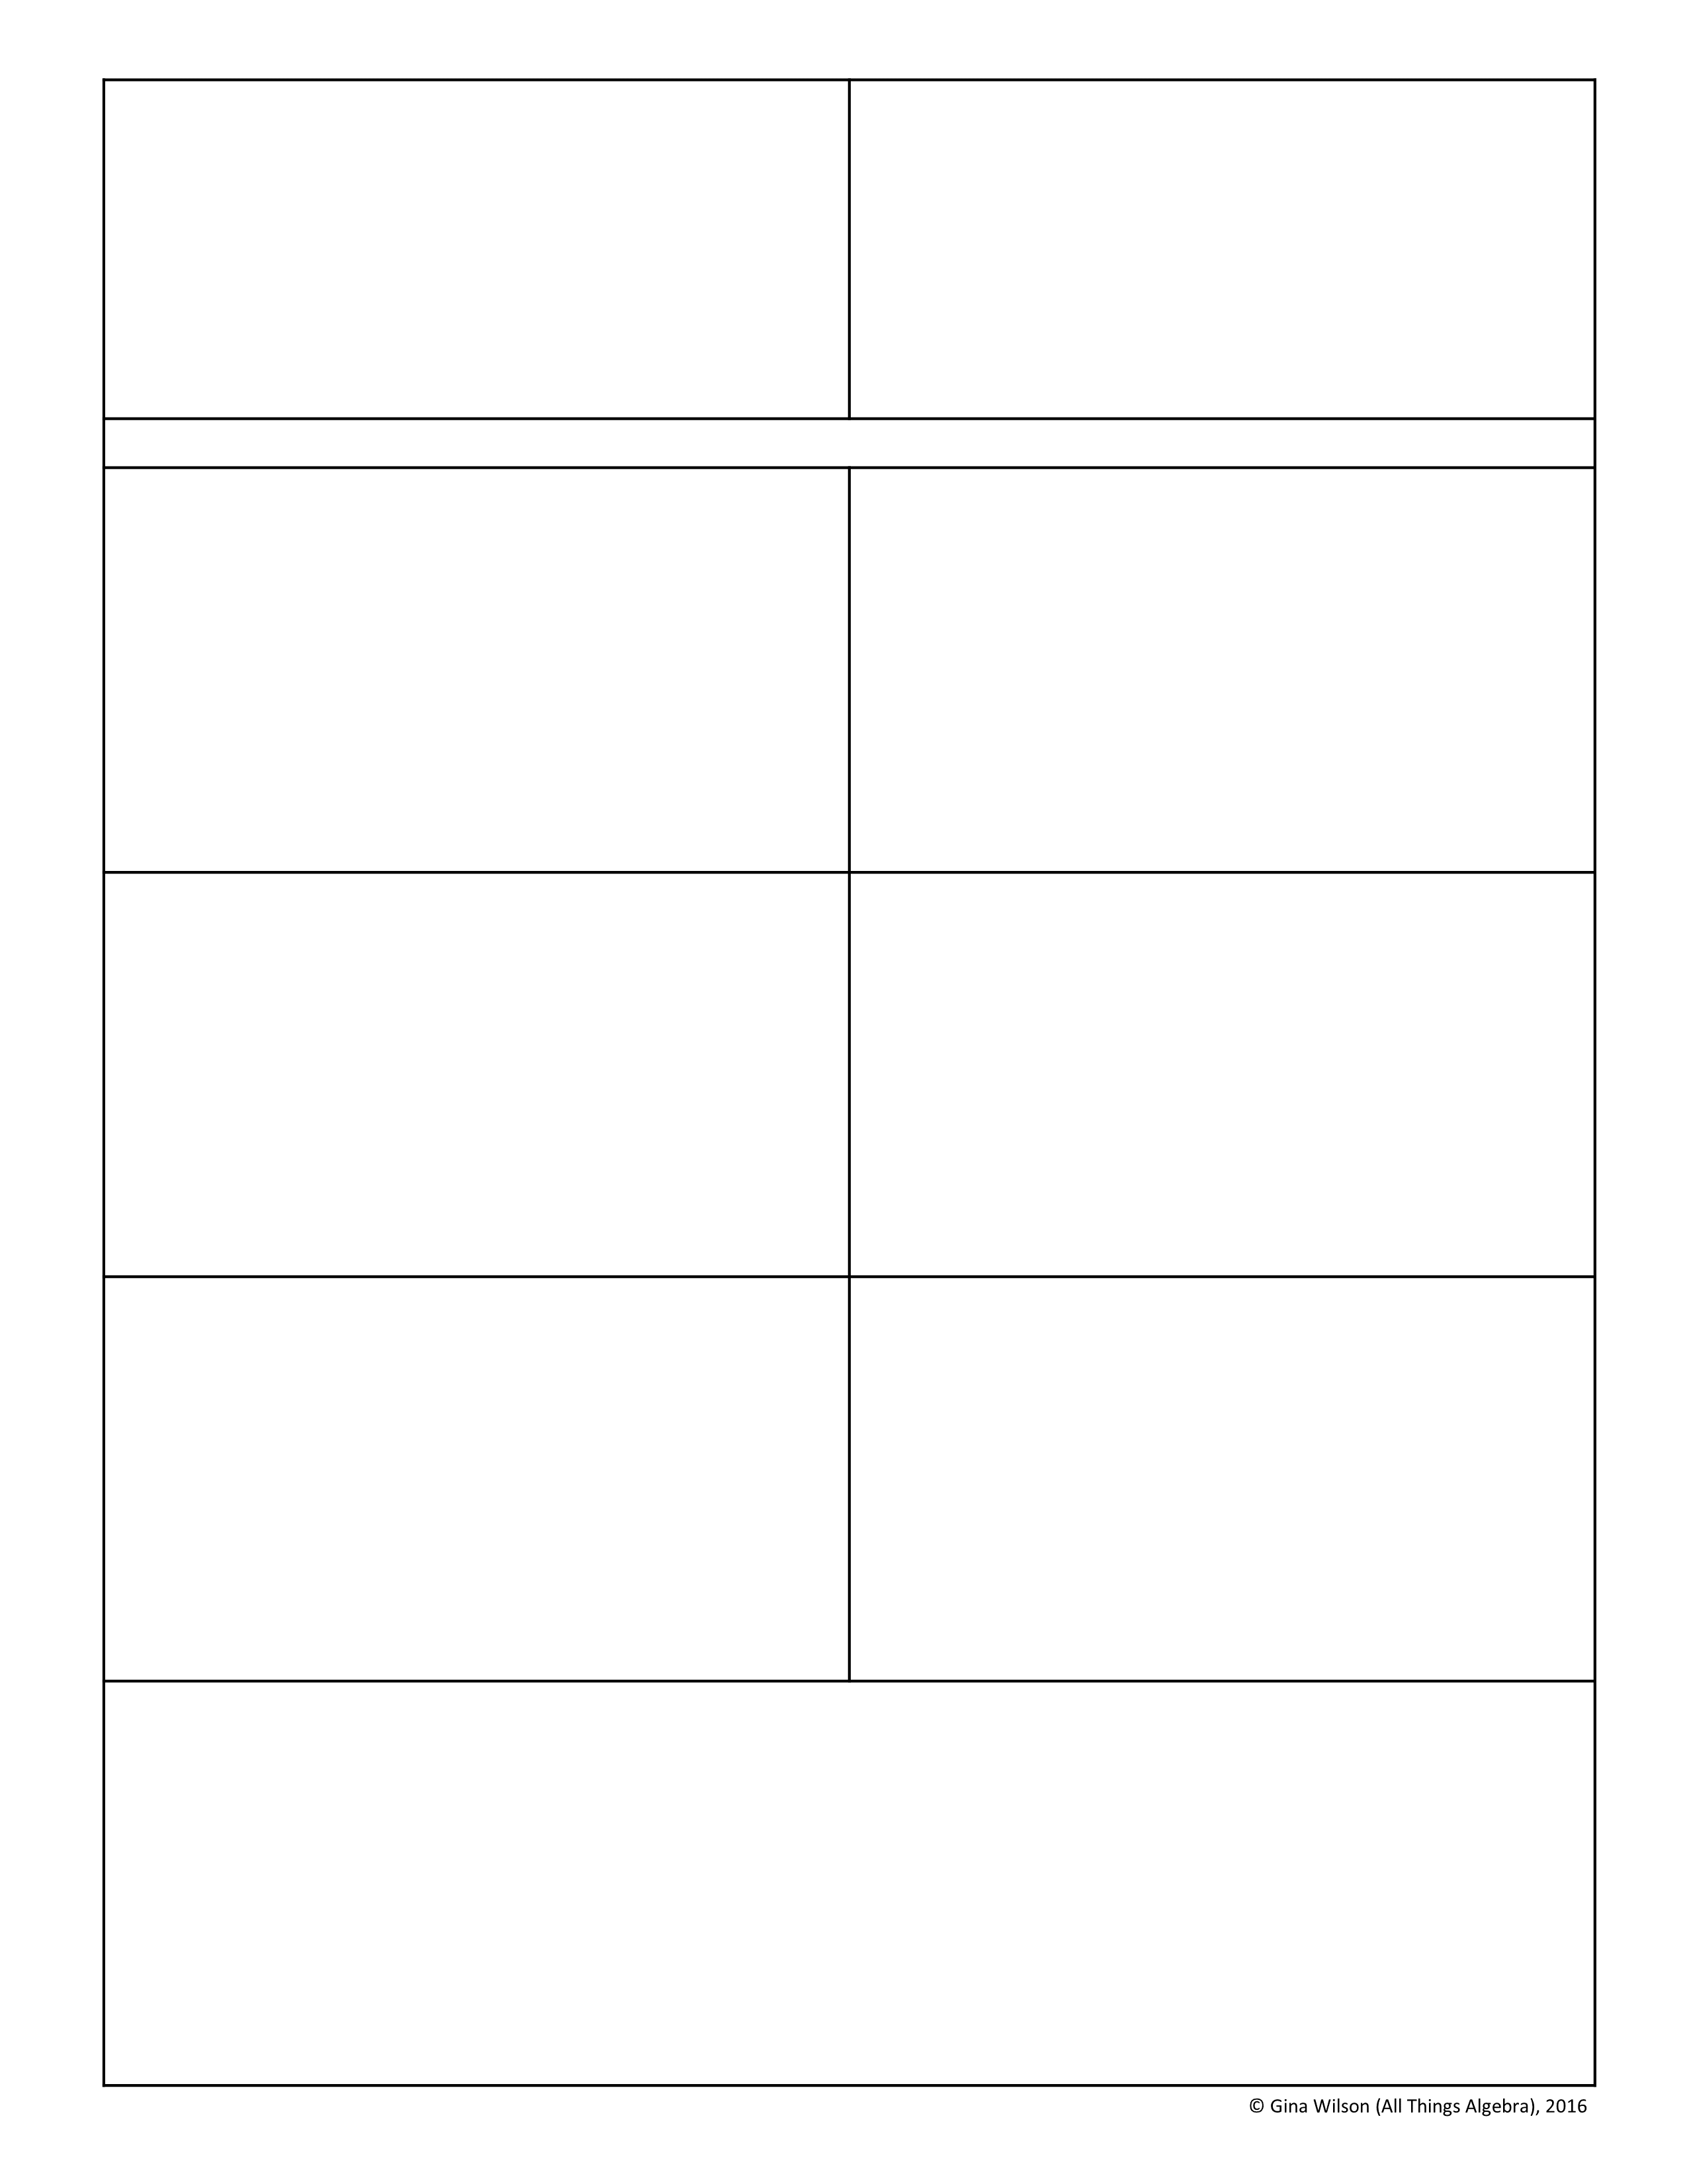

21. If cot θ < 0, in which quadrant(s) could the terminal side of angle θ lie?
22. If sin θ = cos θ, in which quadrant(s) could the terminal side of angle θ lie?
A. II and IV B. II and III C. III only D. IV only
A. I only B. III only C. I and III D. II and IV
For questions 23-26, give the exact value for each trigonometric function.
23. sin 120°
24. csc 225°
A. C. B. D.
A. C. B. D.
25.
26.
A. 0 B. 1 C. -1 D. undefined
A. C. B. D.
27. What function has a value of?
28. What function has a value of 2?
A. C. B. D.
A. C. B. D.
29. Which functions have a value of -1? Check all that apply.

Slide 4
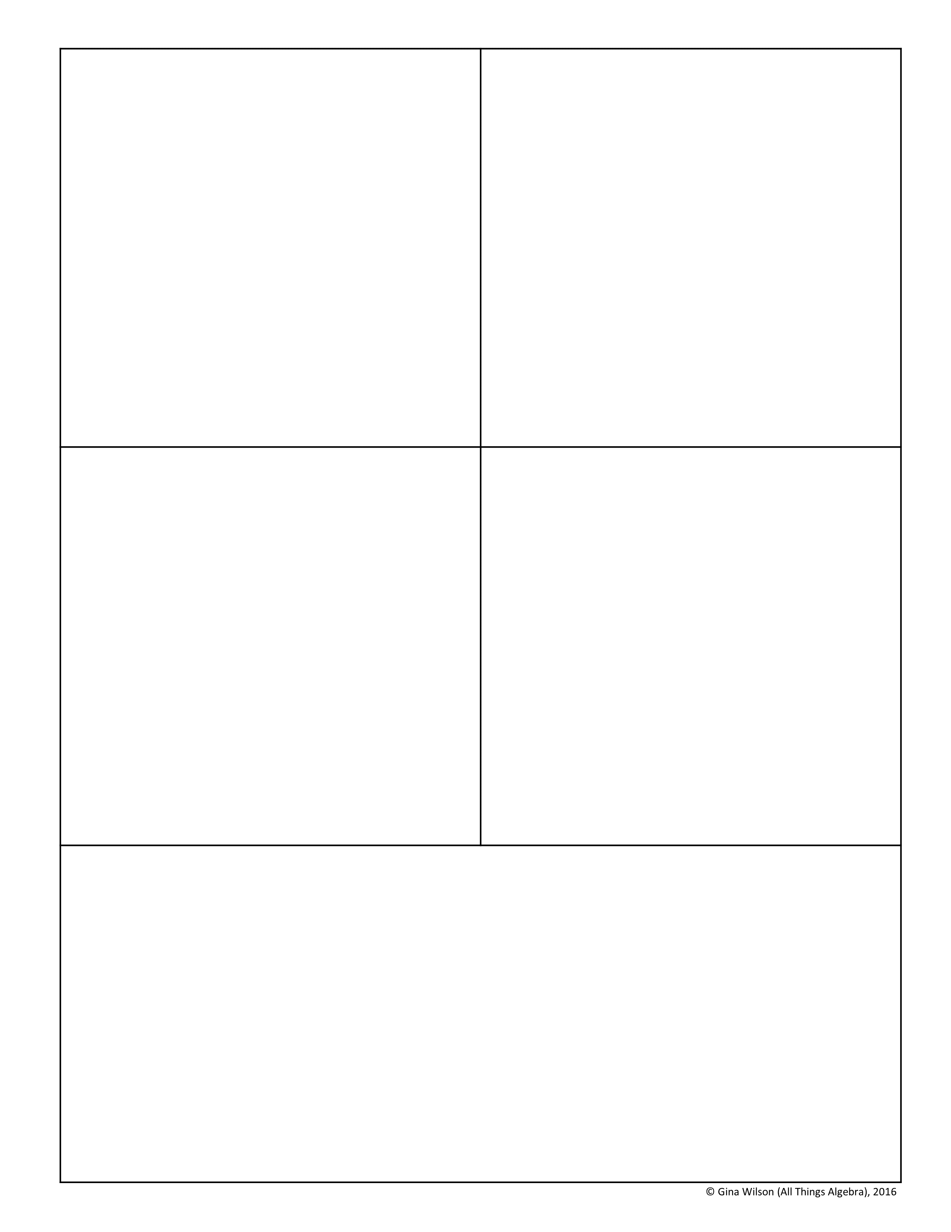
30. Find ST to the nearest tenth.
31. In ΔABC, m∠A = 58°, AC = 22, and BC = 25. Find m∠B.
S
R
28°
73°
T
18
A. 48° B. 74° C. 48° or 132° D. Not Possible
ST =
32. In ΔXYZ, m∠X = 49°, XY = 18, and YZ = 14. Find m∠Y.
33. Find DE to the nearest tenth.
E
115°
15
D
12
F
A. 55° B. 76° C. 76° or 104° D. 55° or 27°
DF =
34. Given ΔJKL with JK = 16, KL = 14, and JL = 10, solve the triangle. Round all answers to the nearest tenth.
m∠J =
m∠K =
m∠L =

Slide 5

35. Given ΔPQR with m∠P = 42°, m∠R = 26°, and PQ = 19, solve the triangle. Round all answers to the nearest tenth.
m∠Q =
QR =
PR =
36. Find the area of the triangle below to the nearest tenth.
56°
7.2 cm
78°
A. 13.7 cm² C. 18.4 cm² B. 12.2 cm² D. 15.8 cm²
37. Find the area of the triangle below to the nearest tenth.
13 ft
20 ft
105°
A. 80.5 ft² C. 76.6 ft² B. 71.3 ft² D. 68.1 ft²
38. A 24-foot ladder is placed against a building to reach a window on the second floor. The angle of depression from the top of the ladder to the bottom of the ladder is 62º. Find the distance between the bottom of the ladder and the base of the building to the nearest tenth of a foot.

Slide 6

39. Alex is standing 60 feet from the base of a flagpole. He measures the angle of elevation to the top of the pole as 35º. Vera is 36 feet closer to the base of the flagpole on a straight level path. Find the angle of elevation from the point Vera is standing to the top of the flagpole to the nearest tenth of a degree.
40. A course in the shape of a triangle consists of a running path, biking path, and skateboarding path. The biking path is 51 meters long and the skateboarding path is 64 meters long. If the angle between the running and biking paths is 78, find the angle between the running and skateboarding paths to the nearest tenth of a degree.
41. The distances from a boat to two buoys are 75 meters and 52 meters. If the angle between the two lines of sight is 67, find the distance between the buoys. Round to the nearest tenth of a meter.
42. A triangular sail on a boat has side lengths that measure 15 feet, 36 feet, and 38 feet. Find the area of the sail to the nearest tenth of a foot.

